Slide 1
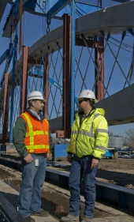
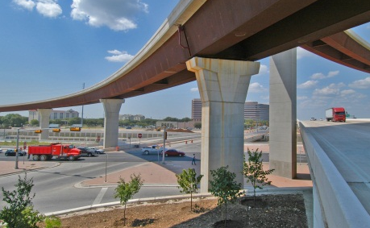
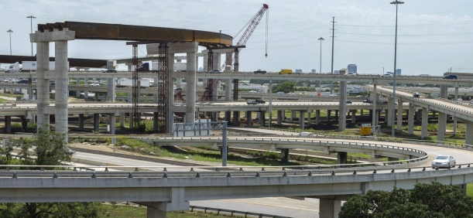
Highway bridge Program
Improving the Safety of Off-System Bridges in Texas

Slide 2
Table of Contents
1
Introduction
3
2
Funding
5
3
Programming Process
10
4
Bridge Condition Performance Measure
24
5
Condition of Texas Bridges
25
6
Comparison to Other States
33
7
Historic Off- System Bridges
34
8
Questions
45

Slide 3
Introduction
Definitions
Bridge: A structure erected over a depression or an obstruction, such as water, a highway or a railway, that carries traffic and has an opening of more than 20-feet between faces of abutments
On-System Bridge: On a designated state highway route (i.e. interstate highways, farm to market roads, state highways, US highways)
State owned and maintained
Examples: IH 10, FM 2222, SH 6, Loop 410, US 183, etc
Off-System Bridge: On a road that is NOT part of the designated state highway system and is under the direct jurisdiction of the local government (i.e. county roads and city streets)
Owned and maintained by local government
Examples: Danforth Rd, County Rd 260, Holly Street, etc
Notes:
Current federal legislation, Moving Ahead for Progress in the 21st Century Act (MAP-21), no longer has a specific highway bridge program; HOWEVER, it does require the States to meet specific performance standards concerning bridges and bridge conditions.
http://www.dot.gov/map21
TxDOT has continued the highway bridge program as a state program as a means of meeting the performance standards outline in the federal legislation and until FHWA develops further guidance on how the performance measures are to be implemented and evaluated.

Slide 4
Introduction
Highway Bridge Program (HBP)
What: TxDOT’s program for using federal Surface Transportation Program (STP) funds for the rehabilitation/replacement of eligible bridges on pubic roads
Where: For publicly owned bridges statewide
When: Established in 1978 through federal legislation; and
Annual program calls for funding projects in 4 to 5 year development plans
Why: To increase the safety of bridges
Notes:
Current federal legislation, Moving Ahead for Progress in the 21st Century Act (MAP-21), no longer has a specific highway bridge program; HOWEVER, it does require the States to meet specific performance standards concerning bridges and bridge conditions.
http://www.dot.gov/map21
TxDOT has continued the highway bridge program as a state program as a means of meeting the performance standards outline in the federal legislation and until FHWA develops further guidance on how the performance measures are to be implemented and evaluated.

Slide 5
Funding
Overview
HBP is fiscally constrained to $230M per fiscal year
$60M – Off-system
Federal funds require a participation match of 20%
Off-system: 80% - Federal
10% - State
10% - Local
-or-
80% - Federal
20% - State*
* If approved in accordance with §15.55(d) of the Texas Administrative Code
Notes:
Highway Bridge Program (HBP) Funds :
are a subset to TxDOT’s CATEGORY 6 FUNDING category outlined in the Unified Transportation Plan (UTP) which is TxDOT’s 10-year plan to guide transportation project development.
http://www.txdot.gov/inside-txdot/division/transportation-planning/utp.html
Federal legislation requires a 20% State or Local funding match for rehabilitating/replacing bridges. To assist the local governments in the State has elected to pay 10% of the local government match thereby leaving the local government responsible for the remaining 10% (or Economically Disadvantage Amount – for more information on how to apply for EDC status please contact the local TxDOT district office).

Slide 6
Funding
Overview
Fiscally constrained at $230M per fiscal year
$60M – Off-system
Federal funds require a 20% cost participation match
Off-system projects (80% federal, 10% state, 10% local)
Local funding participation alternatives
Payment match
Full 10%
Economically Disadvantage Counties program (EDC)
State Infrastructure Bank (SIB)
Participation Waived Project / Equivalent Match Project program (PWP/EMP)
Notes:
Local funding participation may be accomplished in the following ways:
-Payment match
10% participation amount using funding on hand
EDC – adjustment to the local participation amount set by Texas Transportation Minute for a county that, in comparison to other counties in the state (must meet all three):
Below average per capita taxable property value;
Below average per capita income; AND,
Above average unemployment
Cities within an EDC may receive higher percentage adjustments beyond their county’s adjustment under two conditions:
Have a local economical development sales tax
Yes – take an additional 5%
No – no additional %
Population (x) is less than 5000
x < 1000 = 5%
1000 < x < 2000 = 4%
2000 < x < 3000 = 3%
3000 < x < 4000 = 2%
4000 < x < 5000 = 1%
> 5000 = 0%
SIB Loans – revolving account in the State Highway Fund form which loans may be made to local governments for funding critical projects like bridges
- PWP/EMP program
State provides up to a 10% contribution towards their funding match provided the local government does structural improvement work on other deficient bridge(s) or cross-drainage structures in a dollar amount equal to their 10% or EDC match.
EMP work must be approved in writing by the District PRIOR to the work being performed.

Slide 7
Funding
Advanced Funding Agreement (AFA)
Must be executed between the state and local government before any work, either preliminary engineering or construction, can be performed.
Specifies the responsibilities of the parties in the performance and funding of the work,
Defines the contributions of the local government for its share of the project funding responsibilities.
Local government contributions can be either:
advance payments (escrow payments) or
work performed under the Participation Waived/Equivalent-Match Project Program (PWP/ EMP).
Notes:
Local funding participation may be accomplished in the following ways:
-Payment match
10% participation amount using funding on hand
EDC – adjustment to the local participation amount set by Texas Transportation Minute for a county that, in comparison to other counties in the state (must meet all three):
Below average per capita taxable property value;
Below average per capita income; AND,
Above average unemployment
Cities within an EDC may receive higher percentage adjustments beyond their county’s adjustment under two conditions:
Have a local economical development sales tax
Yes – take an additional 5%
No – no additional %
Population (x) is less than 5000
x < 1000 = 5%
1000 < x < 2000 = 4%
2000 < x < 3000 = 3%
3000 < x < 4000 = 2%
4000 < x < 5000 = 1%
> 5000 = 0%
SIB Loans – revolving account in the State Highway Fund form which loans may be made to local governments for funding critical projects like bridges
- PWP/EMP program
State provides up to a 10% contribution towards their funding match provided the local government does structural improvement work on other deficient bridge(s) or cross-drainage structures in a dollar amount equal to their 10% or EDC match.
EMP work must be approved in writing by the District PRIOR to the work being performed.

Slide 8
Funding
Participation Waived Project/Equivalent Match Projects
The local match requirement for off-system bridge program projects may be waived by participation in the PWP/EMP.
Local government agrees to use local funds to perform structural or other safety improvement work on other load-carrying deficient bridges or cross-drainage structures in its jurisdiction.
Must have a dollar value at least equivalent to the required local match participation or local participation as adjusted under the EDC provision.
Requirements defined in 43 TAC Section 15.55(d)
Notes:
Local funding participation may be accomplished in the following ways:
-Payment match
10% participation amount using funding on hand
EDC – adjustment to the local participation amount set by Texas Transportation Minute for a county that, in comparison to other counties in the state (must meet all three):
Below average per capita taxable property value;
Below average per capita income; AND,
Above average unemployment
Cities within an EDC may receive higher percentage adjustments beyond their county’s adjustment under two conditions:
Have a local economical development sales tax
Yes – take an additional 5%
No – no additional %
Population (x) is less than 5000
x < 1000 = 5%
1000 < x < 2000 = 4%
2000 < x < 3000 = 3%
3000 < x < 4000 = 2%
4000 < x < 5000 = 1%
> 5000 = 0%
SIB Loans – revolving account in the State Highway Fund form which loans may be made to local governments for funding critical projects like bridges
- PWP/EMP program
State provides up to a 10% contribution towards their funding match provided the local government does structural improvement work on other deficient bridge(s) or cross-drainage structures in a dollar amount equal to their 10% or EDC match.
EMP work must be approved in writing by the District PRIOR to the work being performed.

Slide 9
Funding
Participation Waived Project/Equivalent Match Projects (continued)
The District receives and considers the completed request for waiver from the Local Government according to requirements of 43 TAC Section 15.55(d).
If the request for waiver meets all requirements and approval is appropriate, the District advises the Local Government in writing of approval.
Execute an AFA for the project.
The District keeps a file of all waivers and EMP projects
Local governments have 3 years to accomplish EMP projects from the time of contract award of the PWP
If not the five-year period for exclusion of the Local Government from such waivers may be invoked, or an extension requested from the Bridge Division.
Notes:
Local funding participation may be accomplished in the following ways:
-Payment match
10% participation amount using funding on hand
EDC – adjustment to the local participation amount set by Texas Transportation Minute for a county that, in comparison to other counties in the state (must meet all three):
Below average per capita taxable property value;
Below average per capita income; AND,
Above average unemployment
Cities within an EDC may receive higher percentage adjustments beyond their county’s adjustment under two conditions:
Have a local economical development sales tax
Yes – take an additional 5%
No – no additional %
Population (x) is less than 5000
x < 1000 = 5%
1000 < x < 2000 = 4%
2000 < x < 3000 = 3%
3000 < x < 4000 = 2%
4000 < x < 5000 = 1%
> 5000 = 0%
SIB Loans – revolving account in the State Highway Fund form which loans may be made to local governments for funding critical projects like bridges
- PWP/EMP program
State provides up to a 10% contribution towards their funding match provided the local government does structural improvement work on other deficient bridge(s) or cross-drainage structures in a dollar amount equal to their 10% or EDC match.
EMP work must be approved in writing by the District PRIOR to the work being performed.

Slide 10
Programming Process
Inspections
Eligibility
Listing
Communication between
TxDOT and locals
Maintenance
Inspections
Proposed
bridge lists prioritized & ranked
Project construction
Communication
Program bridges based on program requirements
Project lettings & monitoring funding
Develop projects
Notes:
The entire process is constantly in motion. Although the program call occurs only once a FY, the process remains fluid to allow for emergencies and other safety concerns that develop mid-cycle.

Slide 11
Programming Process
continuous
2 months
2 months
continuous
Inspections and Eligibility Process
Project Selection Process
PART A
Project Selection Process
PART B
Project Development Process
Monthly Monitoring Process
Inspect
Classify
Distribution/ Notification of Eligibility List
Districts and local officials work together to prioritize and rank candidate bridges thus determining which bridges should be submitted for funding consideration
Districts submit bridge: priority, rank, and estimate for bridges that are to be considered
Bridge Division prioritizes and ranks bridges submitted on a statewide basis
Execute Advance Funding Agreement
Begin project development
Bridge Division reviews HBP fund balance
Projects may be delayed / accelerated based on funds available and project eligibility
Emergency projects may be added
RESULTS:
A. Projects proceed as programmed
B. Project schedules may change
C. Communication between TxDOT & local entity
RESULT:
Eligibility List for HBP
RESULT:
District Proposed Project Lists
RESULT:
Statewide List of Funded Bridge Projects
RESULT:
Adjustment of Statewide List of Funded Bridge Projects to uphold fiscal constraints
Notes:
How do bridges become eligible for the HBP funds?.....See slide 9
How do the funds get distributed?...See slide 14
The programming process is on-going and continuous… Beginning with the inspection of the existing bridge

Slide 12
Programming Process
continuous
2 months
2 months
continuous
Inspections and Eligibility Process
Project Selection Process
PART A
Project Selection Process
PART B
Project Development Process
Monthly Monitoring Process
Inspect
Classify
Distribution/ Notification of Eligibility List
Districts and local officials work together to prioritize and rank candidate bridges thus determining which bridges should be submitted for funding consideration
Districts submit bridge: priority, rank, and estimate for bridges that are to be considered
Bridge Division prioritizes and ranks bridges submitted on a statewide basis
Execute Advance Funding Agreement
Begin project development
Bridge Division reviews HBP fund balance
Projects may be delayed / accelerated based on funds available and project eligibility
Emergency projects may be added
RESULTS:
A. Projects proceed as programmed
B. Project schedules may change
C. Communication between TxDOT & local entity
RESULT:
Eligibility List for HBP
RESULT:
District Proposed Project Lists
RESULT:
Statewide List of Funded Bridge Projects
RESULT:
Adjustment of Statewide List of Funded Bridge Projects to uphold fiscal constraints
Notes:
Just as there are requirements for funding the rehabilitation/replacement of the nation’s bridges; there is federal law and requirements that outline how bridges are to be inspected.

Slide 13
Programming Process
Inspections and Eligibility
Inspection
Basis by which bridge programming is set upon
All publicly owned vehicular bridges are inspected at 24 months intervals (some more frequently)
Inspections must meet federal standards and reported to FHWA
Structurally Deficient (SD)
Functionally Obsolete (FO)
Sufficiency Rating (23 CFR 650.409)
Eligibility Requirements
Structurally Deficient or Functionally Obsolete
And
Sufficiency Rating < 80
(FHWA calculation)
Classification
Result: Eligibility List
Notes:
To answer the first question……How do bridges become eligible for the HBP funds?
All publicly owned vehicular bridges are required to have routine inspections at most every 24 months. Depending on the condition and type, a bridge may be inspected on a more frequent basis.
Example: Some bridges require special inspections because they are classified as fracture critical (thus requiring fracture critical inspections) and/or scour critical bridges (thus requiring underwater inspections)
Each inspection, which must meet federal standards, evaluates numerous elements of the bridge including its surroundings. It is the combination of the element scores that result in the Sufficiency Rating and bridge condition status of Structurally Deficient or Functional Obsolete.

Slide 14
Programming Process
Inspections and Eligibility
Structurally Deficient (SD)
Has extreme restriction on load carrying capacity
Has deterioration sever enough to reduce the load carrying capacity from original as-built levels
Requires immediate rehabilitation to remain open
Is closed
Is frequently overtopped during flooding and creates severs traffic delays
Functionally Obsolete (FO)
Bridge width
Load carrying capacity
Vertical or horizontal clearances
Alignment between bridge and approaches
Sufficiency Rating (SR) Formula (calculated)
SR = S₁ + S₂ + S₃ + S₄ (# between 0 – 100)
S₁ = Structural Adequacy and Safety (55% - 0%)
S₂ = Serviceability and Functional Obsolescence (30% - 0%)
S₃ = Essentiality for Public Use (15% - 0%)
S₄ = Special Reduction (If S₁ + S₂ + S₁ > 50)
Inspection
Classification
Result: Eligibility List
Notes:
Structurally Deficient (SD)
Has extreme restriction on load carrying capacity
Has deterioration sever enough to reduce the load carrying capacity from original as-built levels
Requires immediate rehabilitation to remain open
Is closed
Is frequently overtopped during flooding and creates severs traffic delays
Functionally Obsolete (FO)
Bridge Width
Load Carrying Capacity
Vertical Horizontal Clearances
Alignment between bridge and approaches
The formula for determining is fairly complex with the individual elements of the formula based on the following:
SR = S₁ + S₂ + S₃ + S₄ (# between 0 – 100)
S₁ = Structural Adequacy and Safety (55% - 0%)
S₂ = Serviceability and Functional Obsolescence (30% - 0%)
S₃ = Essentiality for Public Use (15% - 0%)
S₄ = Special Reduction (If S₁ + S₂ + S₁ > 50)

Slide 15
Programming Process
Inspections and Eligibility
Eligible for Rehabilitation
Structurally Deficient or Functionally Obsolete
And
Sufficiency Rating < 80
Eligible for Replacement
Structurally Deficient or Functionally Obsolete
And
Sufficiency Rating < 50
Result: Eligibility List
Bridge Classification
Sufficiency Rating
Eligible for HBP Funding
Not SD/FO OR 81 – 100 Not Eligible
SD/FO AND 50 – 80 Eligible for Rehabilitation
SD/FO AND 0 – 49 Eligible for Replacement
Notes:
So once again…. How do bridge become eligible for HBP funds?
Bridges have to meet the program requirements: SD/FO and have a SR <80….

Slide 16
Programming Process
continuous
2 months
2 months
continuous
Inspections and Eligibility Process
Project Selection Process
PART A
Project Selection Process
PART B
Project Development Process
HBP Monthly Monitoring Process
Inspect
Classify
Distribution/ Notification of Eligibility List
Districts and local officials work together to prioritize and rank candidate bridges thus determining which bridges should be submitted for funding consideration
Districts submit bridge: priority, rank, and estimate for bridges that are to be considered
Bridge Division prioritizes and ranks bridges submitted on a statewide basis
Execute Advance Funding Agreement
Begin project development
Bridge Division reviews HBP fund balance
Projects may be delayed / accelerated based on funds available and project eligibility
Emergency projects may be added
RESULTS:
A. Projects proceed as programmed
B. Project schedules may change
C. Communication between TxDOT & local entity
RESULT:
Eligibility List for HBP
RESULT:
District Proposed Project Lists
RESULT:
Statewide List of Funded Bridge Projects
RESULT:
Adjustment of Statewide List of Funded Bridge Projects to uphold fiscal constraints
Notes:
Beginning of the selection process = COMMUNICATION!!!!!
Since the funds are for statewide use, the Bridge Division is responsible for managing the funds. An annual program call for new candidate projects is conducted. It begins with each TxDOT district receiving a listing of bridges under their purview that meet the eligibility requirements.

Slide 17
Programming Process
Project Selection Process: Part A
Distribute Eligibility List
BRG notifies districts of program call based on eligible bridge list
District specific lists in the Bridge Portfolio Management application
Districts work with local officials to
Evaluate currently approved bridges to verify project need and funding
Determine new candidate bridges to submit for consideration
Set bridge priorities and rankings for candidate bridges
Districts update/upload estimates, proposed letting dates, project needs, district/local priorities, and district/local rankings for previously approved bridges and new candidate bridges to be considered for programming
Bridge Priorities/Rankings
Statewide Proposed
Bridge Project Listing
Notes:
The districts are given approximately 2 months to coordinate with local officials to select the bridges they believe are best candidates for submitting for funding consideration.
New in FY 14 Bridge Division rolled out the Bridge Portfolio Management Application… Which makes the programming process more transparent.

Slide 18
Programming Process
Project Selection Process: Part B
BRG reviews proposed bridge project list
Verifies eligibility, estimates, proposed lettings dates, project needs, district/local priorities have been entered
Ensures special consideration justifications have been provided, as needed
BRG evaluates bridge project list
Updates currently approved project estimates and letting dates based on district information and fiscal constraints to determine available funding within the programming FYs
Evaluates and selects bridges
1st round: SD/FO with SR < 50 & Approved special consideration projects
2nd round: SD/FO with SR < 80
district/local priorities and rankings break ties and ensure the project with the highest need are selected
BRG Review of Statewide Proposed Project Listing
Prioritization of Bridges
Lower
Higher
Probability of being programmed
SR =
Statewide Approved
Bridge Project Listing
Notes:
Second Question: How do the funds get distributed?
Bridge Division:
reviews the candidate bridges
prioritizes/ranks the bridges on a STATEWIDE basis
distributes the available funds to the highest prioritized/ranked bridges
Bridge Division is currently in the programming process for FY 14-FY 19. Districts have submitted their candidate bridges for consideration.
Depending on the available funds and the number of eligible bridges submitted for consideration, the process could take up to 3 months to develop the statewide program listing of potential projects. Not all of the bridges submitted during the program call will be selected, and those that are selected may not get funded in their originally requested fiscal year.

Slide 19
Programming Process
continuous
2 months
2 months
continuous
Inspections and Eligibility Process
Project Selection Process
PART A
Project Selection Process
PART B
Project Development Process
Monthly Monitoring Process
Inspect
Classify
Distribution/ Notification of Eligibility List
Districts and local officials work together to prioritize and rank candidate bridges thus determining which bridges should be submitted for funding consideration
Districts submit bridge: priority, rank, and estimate for bridges that are to be considered
Bridge Division prioritizes and ranks bridges submitted on a statewide basis
Execute Advance Funding Agreement
Begin project development
Bridge Division reviews HBP fund balance
Projects may be delayed / accelerated based on funds available and project eligibility
Emergency projects may be added
RESULTS:
A. Projects proceed as programmed
B. Project schedules may change
C. Communication between TxDOT & local entity
RESULT:
Eligibility List for HBP
RESULT:
District Proposed Project Lists
RESULT:
Statewide List of Funded Bridge Projects
RESULT:
Adjustment of Statewide List of Funded Bridge Projects to uphold fiscal constraints
Notes:
As previously mentioned the HBP is part of the UTP (which contains 10 years worth of projects) but the HBP only programs projects out for 5 years.
Since bridge conditions can change rapidly (example: Eagle Ford Shale oil drilling) bridges that were once in satisfactory condition have had their service lives reduced due to the increased traffic demands.

Slide 20
Programming Process
Project Development Process
Develop Projects
BRG notifies districts and other divisions of the approved bridge project list
Projects may be developed upon being approved for the program; however, project development is based on resource availability and fiscal constraints
Development time varies
Projects may be accelerated/delayed
Availability of funds
Change orders
Program over-runs/under-runs
Revised estimates
Design complexity
Emergency projects
Force majeure
Environmental and/or ROW clearance
Local priorities
A
B
C
Result A Projects proceed as programmed
Result B
Project schedules may change
Result C
Communication between TxDOT & local entity
Notes:
Bridge Division notifies the Districts as well as Finance and Transportation Planning and Programming Divisions of the approved project lists.
Although once a bridge is approved for funding within any of the program years, project development is restricted to district/division/consultant availability. For the Off-system bridges, local entity resources (personnel, finances, etc.) are also a potential constraint as to whether or not projects are able to move forward.
This is where COMMUNICATION between TxDOT and the Locals is critical.

Slide 21
Programming Process
continuous
2 months
2 months
continuous
Inspections and Eligibility Process
Project Selection Process
PART A
Project Selection Process
PART B
Project Development Process
Monthly Monitoring Process
Inspect
Classify
Distribution/ Notification of Eligibility List
Districts and local officials work together to prioritize and rank candidate bridges thus determining which bridges should be submitted for funding consideration
Districts submit bridge: priority, rank, and estimate for bridges that are to be considered
Bridge Division prioritizes and ranks bridges submitted on a statewide basis
Bridge Division reviews HBP fund balance
Projects may be delayed / accelerated based on funds available and project eligibility
Emergency projects may be added
Execute Advance Funding Agreement
Begin project development
RESULTS:
A. Projects proceed as programmed
B. Project schedules may change
C. Communication between TxDOT & local entity
RESULT:
Eligibility List for HBP
RESULT:
District Proposed Project Lists
RESULT:
Statewide List of Funded Bridge Projects
RESULT:
Adjustment of Statewide List of Funded Bridge Projects to uphold fiscal constraints

Slide 22
Programming Process
Monthly Monitoring Process
Monitoring of monthly lettings for project over-runs/under-runs
Coordinating with Finance Division to developed balanced monthly lettings and reviewing funding constraints
Coordinating with districts throughout project development process to adjust project letting dates due to design, row, etc. issues
Reviews request project change orders and approves/denies
Incorporating emergency and preventative maintenance projects
Continual optimization of program while meeting the organizational strategic goals and federal performance measures
Monthly Project Lettings
Change Orders
Result: Adjustment of Statewide List of Funded Bridge Projects to uphold fiscal constraints

Slide 23
Programming Process Review
Inspections
Eligibility
Listing
Communication between
TxDOT and locals
Maintenance
Inspections
Proposed
bridge lists prioritized & ranked
Project construction
Communication
Program bridges based on program requirements
Project lettings & monitoring funding
Develop projects
Notes:
The entire process is constantly in motion. Although the program call occurs only once a FY, the process remains fluid to allow for emergencies and other safety concerns that develop mid-cycle.

Slide 24
Bridge Condition Performance Measure
80% of all Texas bridges in “good or better” condition
“Good or Better”
Meets current federal and state requirements
Not SD/FO
Not sub-standard for load only
Not SD/FO but has a load capacity less than the maximum legal load
Not deteriorated enough to reduce its load capacity beneath its original as-built capacity, but its as-built capacity was not designed to carry currently legal loads
Load posted or recommended for load posting
Current status: 82.0% of all Texas bridges are in “good or better” condition (as of September 2016)
Notes:
How does this program work to meet the performance measures?
The current performance measure that we have is 80% good or better.
Good or Better is defined as:
Meets current federal and state requirements
Not SD/FO
Not sub-standard for load only… this is a state not federal requirement
At the end of FY 12 Texas had 81.8% of its bridges in “Good or Better” condition… up from 81.2% in 2012

Slide 25
Condition of Texas Bridges
By Count 2016: On- & Off-system
Notes:
As of September 2016 = 53,875 publically owned vehicular bridges (off- and on-system)
This number varies each year (generally increases) based on the number of new bridges added and/or removed from the inspection inventory.

Slide 26
Condition of Texas Bridges
By Count 2014: Off-system only
Notes:
September 2016 = 18,386 publically owned off-system bridges
This is where we need the local entities to assist. TxDOT can only provide recommendations to the local entities. It is up to the local entities to follow the recommendations provided in the routine inspections.

Slide 27
Condition of Texas Bridges
Change in Condition: On- & Off-system
Fiscal Year | SD Bridges | FO Bridges | Sub-standard for Load Only Bridges (not eligible) | Good or Better Bridges | % Good or Better Bridges
2006 | 2,125 | 7,802 | 1,409 | 49,829 | 77.3%
2016 | 865 | 7,783 | 1,032 | 53,875 | 82.0%
Change | -1,260 | -19 | -377 | +4,046 | +4.8%
Change in Condition: Off-system Only
Fiscal Year | SD Bridges | FO Bridges | Sub-standard for Load Only Bridges (not eligible) | Good or Better Bridges | % Good or Better Bridges
2006 | 1,642 | 3,851 | 1,304 | 10,358 | 60.4%
2016 | 678 | 4,144 | 952 | 12,612 | 68.6%
Change | -964 | -293 | -352 | +2,254 | +8.2%
Notes:
In 2011 There were 1178 off-system SD bridges since then we have reduced this number to 832 a change of 346 (average of 115/year)

Slide 28
Condition of Texas Bridges
% of “Good or Better”: On -& Off-system
(as of September 2016)

Slide 29
Condition of Texas Bridges
Number of SD Bridges: On -& Off-system
(as of September 2016)

Slide 30
Condition of Texas Bridges
Number of SD Bridges: Off-system
(as of September 2016)

Slide 31
Condition of Texas Bridges
Highway Bridge Program: History
Year | Number of Bridges Replaced or Rehabilitated On-System | Federal Aid HBP Funds On-System ($M) | Number of Bridges Replaced or Rehabilitated Off-System | Federal Aid HBP Funds Off-System ($M) | Total Number of Bridges Replaced or Rehabilitated | Total Federal Aid HBP Funds ($M)
1978 -1987 | 360 | $296.06 | 232 | $52.51 | 592 | $348.57
1988 | 92 | $41.21 | 37 | $7.46 | 129 | $48.67
1989 | 80 | $33.17 | 142 | $22.80 | 222 | $55.97
1990 | 137 | $49.15 | 125 | $19.60 | 262 | $68.75
1991 | 52 | $31.14 | 67 | $12.29 | 119 | $43.43
1992 | 90 | $52.91 | 63 | $18.41 | 153 | $71.32
1993 | 72 | $83.96 | 30 | $16.20 | 102 | $100.16
1994 | 67 | $37.22 | 52 | $14.27 | 119 | $51.49
1995 | 99 | $87.36 | 100 | $23.91 | 199 | $111.27
1996 | 58 | $72.85 | 78 | $19.04 | 136 | $91.89
1997 | 48 | $52.12 | 99 | $20.12 | 147 | $72.24
1998 | 47 | $61.40 | 80 | $21.40 | 127 | $82.80
1999 | 63 | $133.00 | 95 | $30.10 | 158 | $163.10
2000 | 90 | $112.00 | 102 | $24.80 | 192 | $136.80
2001 | 62 | $68.33 | 131 | $41.78 | 193 | $110.11
2002 | 79 | $84.27 | 125 | $28.63 | 204 | $112.90
2003 | 86 | $213.72 | 134 | $32.37 | 220 | $246.09
2004 | 69 | $87.06 | 153 | $45.58 | 222 | $132.64
2005 | 93 | $136.10 | 136 | $38.10 | 229 | $174.20
2006 | 145 | $198.25 | 146 | $52.02 | 291 | $250.27
2007 | 119 | $232.78 | 170 | $54.06 | 289 | $286.84
2008 | 140 | $200.90 | 105 | $46.40 | 245 | $247.30
2009 | 106 | $134.77 | 133 | $48.96 | 239 | $183.73
2010 | 86 | $186.54 | 154 | $56.84 | 240 | $243.38
2011 | 59 | $171.19 | 115 | $84.36 | 174 | $255.55

Slide 32
Condition of Texas Bridges
Highway Bridge Program: History
Year | Number of Bridges Replaced or Rehabilitated On-System | Federal Aid HBP Funds On-System ($M) | Number of Bridges Replaced or Rehabilitated Off-System | Federal Aid HBP Funds Off-System ($M) | Total Number of Bridges Replaced or Rehabilitated | Total Federal Aid HBP Funds ($M)
2012 | 67 | $135.16 | 118 | $38.29 | 185 | $173.45
2013 | 102 | $227.04 | 108 | $34.48 | 210 | $261.52
2014 | 103 | $95.62 | 129 | $32.19 | 232 | $127.81
2015 | 151 | $111.23 | 112 | $28.43 | 236 | $139.66
Totals | 2822 | $3,426.51 | 3,271 | $965.40 | 6093 | $4,391.91
10-Yr. Avg. | 108 | $169.35 | 129 | $47.60 | 237 | $216.95

Slide 33
Comparison to Other States
Average Daily Traffic on SD Bridges
On-System SD Bridges
On- and Off-system SD Bridges
Texas has the lowest percent of traffic on the bridges that are considered structurally deficient of any other state in the country
Source: Transportation for America, March 30, 2011
Texas has the lowest percentage of on-system SD bridges in the country
Source: Better Road Magazine, 2011
Only two states have a smaller percentage of on- and off-system SD bridges, combined, than Texas
Source: Transportation for America, March 30, 2011

Slide 34
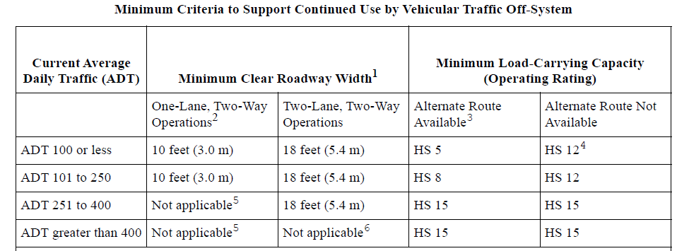
Historic Off-System Bridges
On or Eligible for National Register of Historic Places
Environmental clearance
Trusses can be picked up and moved to a pedestrian location
Bridges replaced with federal funds that are identified as historically significant may be preserved for adaptive reuse with federal fund participation up to the estimated demolition cost.
Historic structures have lower minimum criteria to stay in vehicular use
Notes:
Highway Bridge Program (HBP) Funds :
are a subset to TxDOT’s CATEGORY 6 FUNDING category outlined in the Unified Transportation Plan (UTP) which is TxDOT’s 10-year plan to guide transportation project development.
http://www.txdot.gov/inside-txdot/division/transportation-planning/utp.html
Federal legislation requires a 20% State or Local funding match for rehabilitating/replacing bridges. To assist the local governments in the State has elected to pay 10% of the local government match thereby leaving the local government responsible for the remaining 10% (or Economically Disadvantage Amount – for more information on how to apply for EDC status please contact the local TxDOT district office).

Slide 35
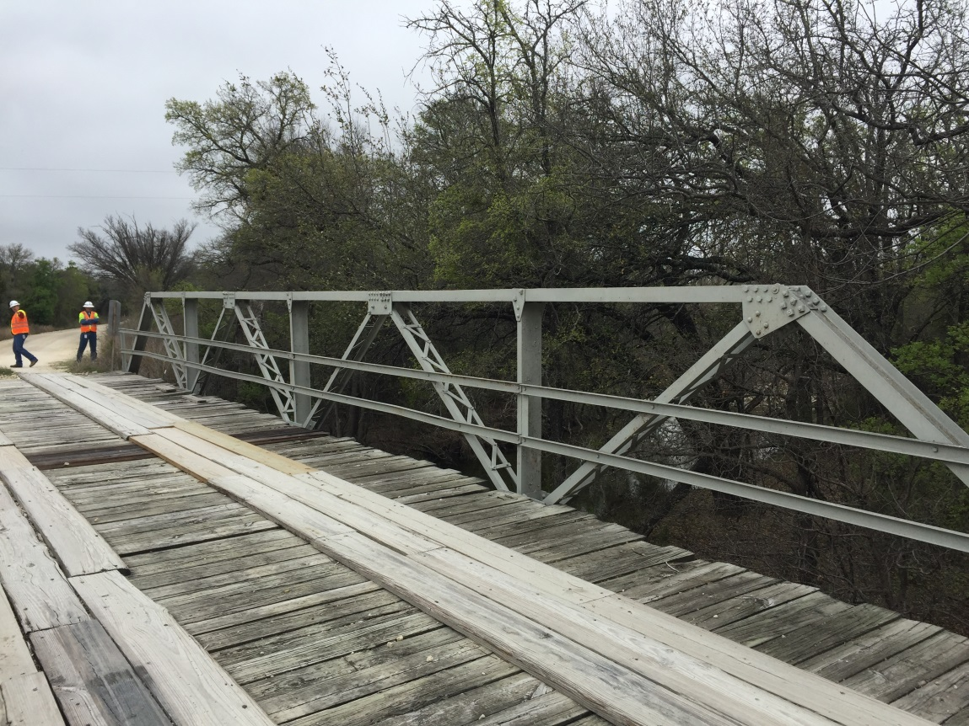
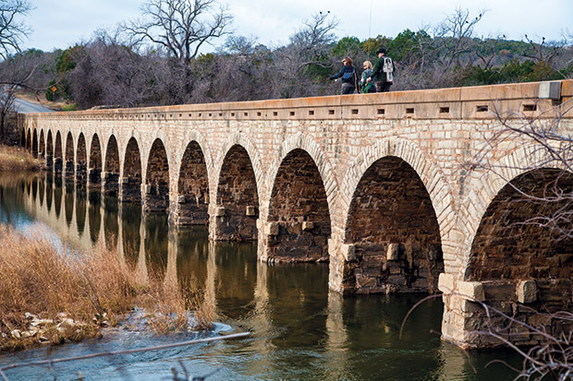
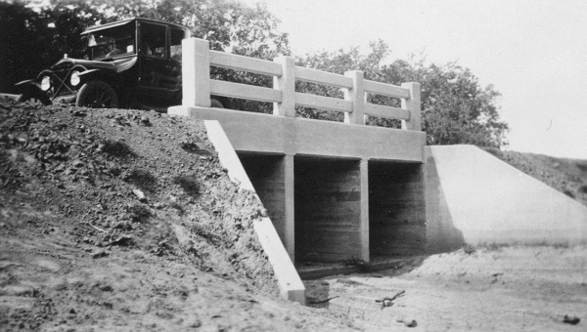
What is a Historic Bridge?
Notes:
Could be something grand, like this masonry bridge
Or, a smaller metal truss bridge
Or, even a concrete box culvert
Or, the Regency Suspension bridge, one of only a couple of suspension bridges remaining in Texas.

Slide 36
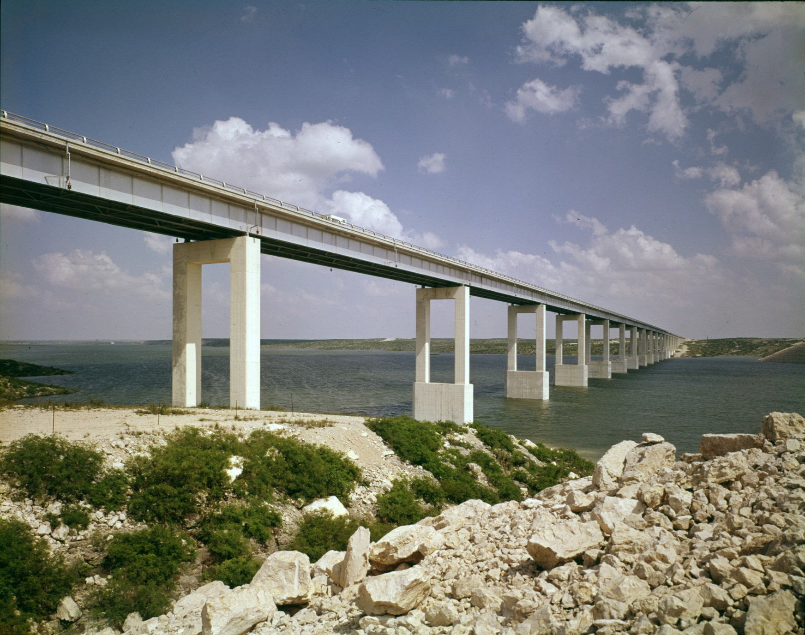
What is a Historic Bridge?
Notes:
Must be at least 50 years old
In TxDOT land, must still carry vehicular traffic
Must be eligible for the National Register of Historic Places
Significance—transportation, engineering, design
Integrity—same location, not widened, not changed much
Texas has close to 600 historic vehicular bridges
Doesn’t include railroad bridges
Bypassed bridges
Moved bridges

Slide 37
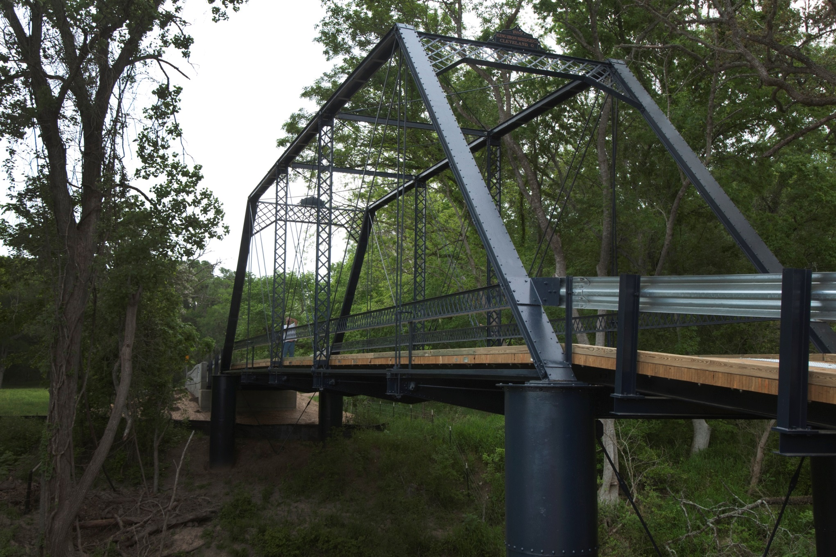
Who Owns Historic Bridges?
Notes:
Common bridge types owned by counties include:
1. Metal truss bridges

Slide 38
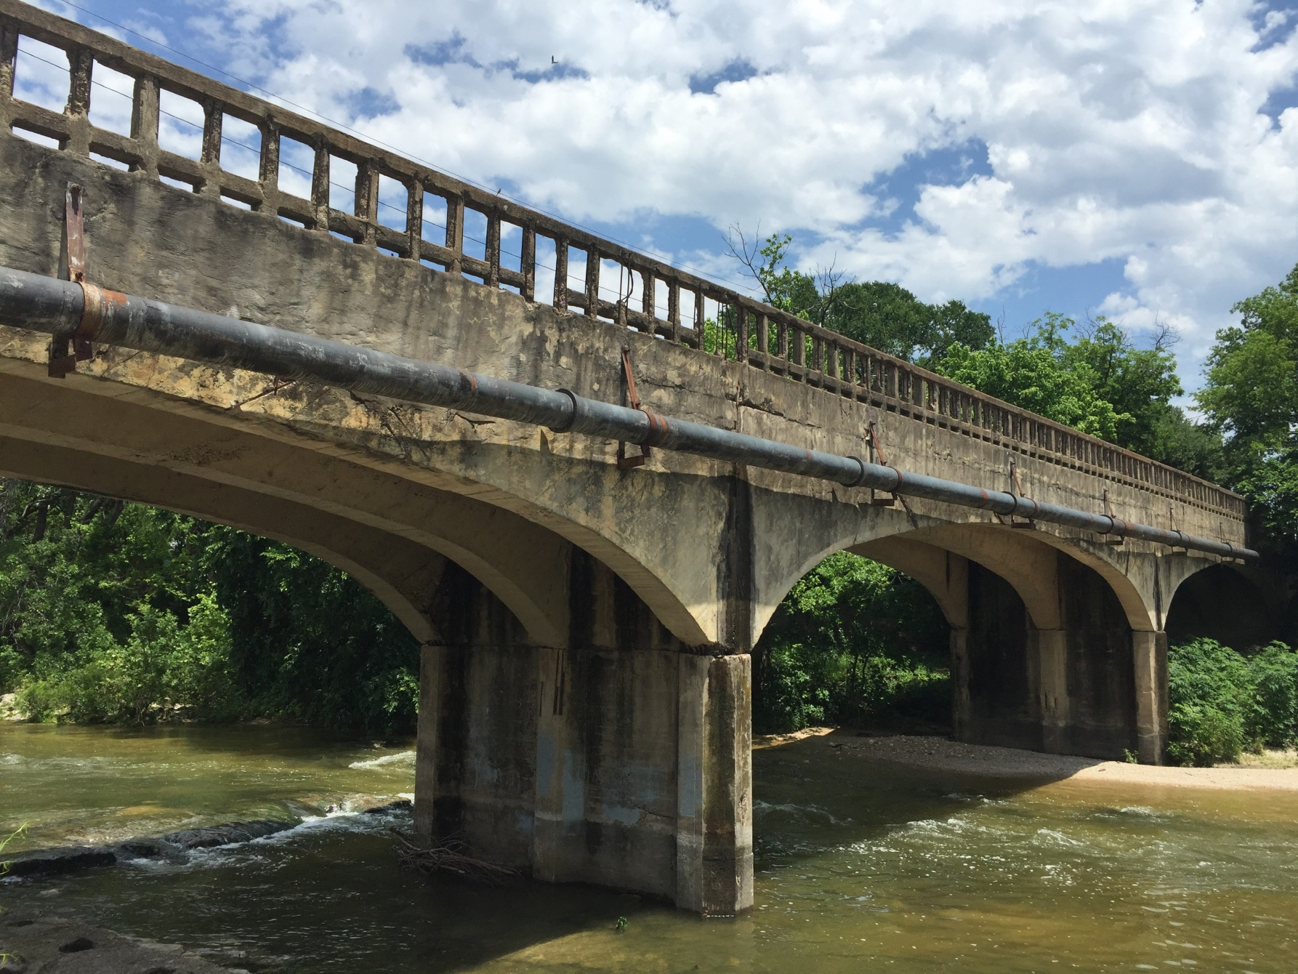
Who Owns Historic Bridges?
Notes:
Common bridge types owned by counties include:
1. Concrete bridges

Slide 39
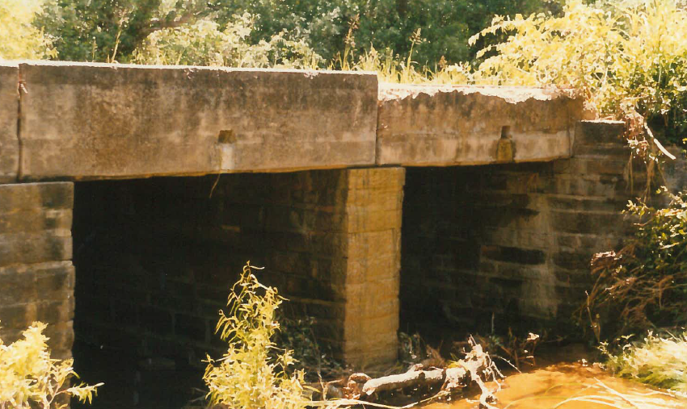
Who Owns Historic Bridges?
Notes:
Common bridge types owned by counties include:
1. Depression-era masonry bridges

Slide 40
How Do I Know if a Bridge is Historic?
Notes:
TxDOT has a handy GIS map showing the location of historic vehicular bridges across the state. The red dots are those bridges that have gone through the formal listing process to be listed in the National Register of Historic Places. The green dots are those that are historic, but don’t have this formal designation.
You may also want to talk with your County Historical Commission to see if they are aware of historic bridges in your county.

Slide 41
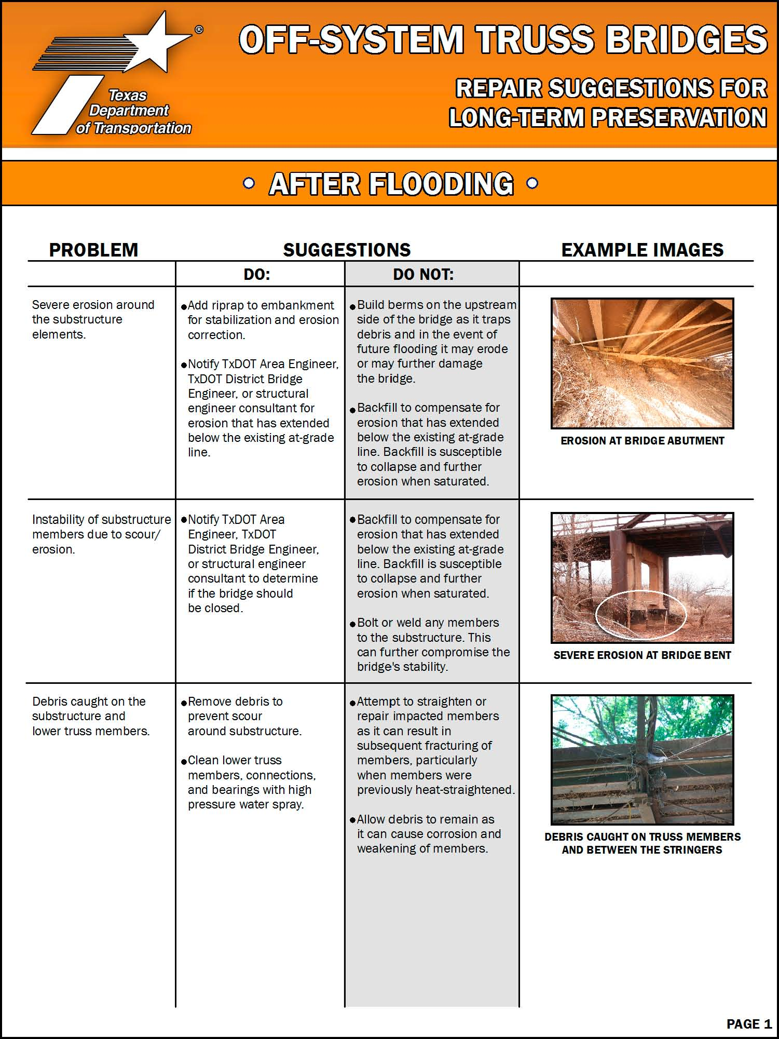
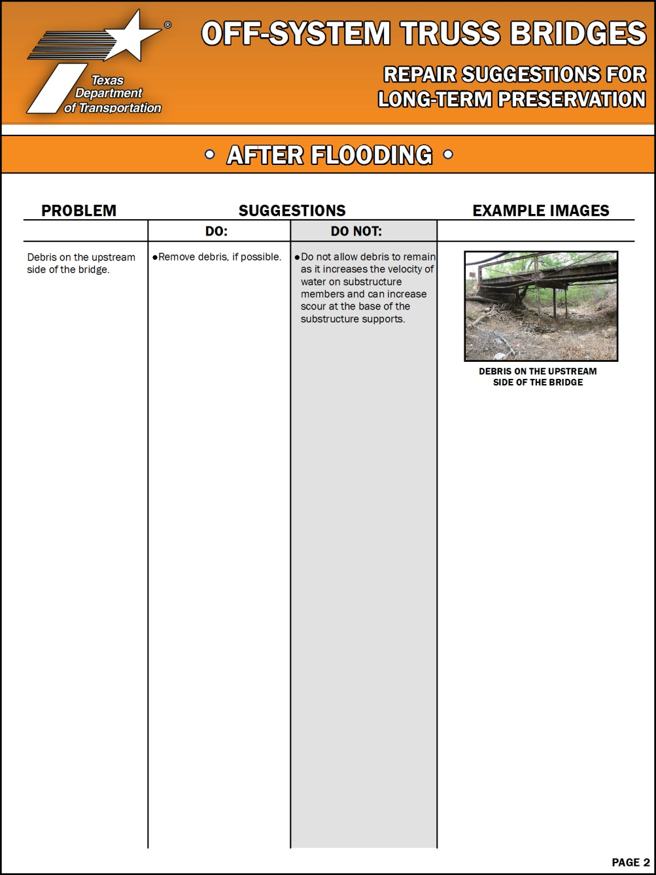
My Bridge is Historic, Now What?
Notes:
TxDOT also has a toolkit to assist metal truss bridge owners in maintaining and repairing their metal truss bridges, outside of a large rehabilitation or replacement project. I’ve brought copies of the toolkits for anyone interested.

Slide 42
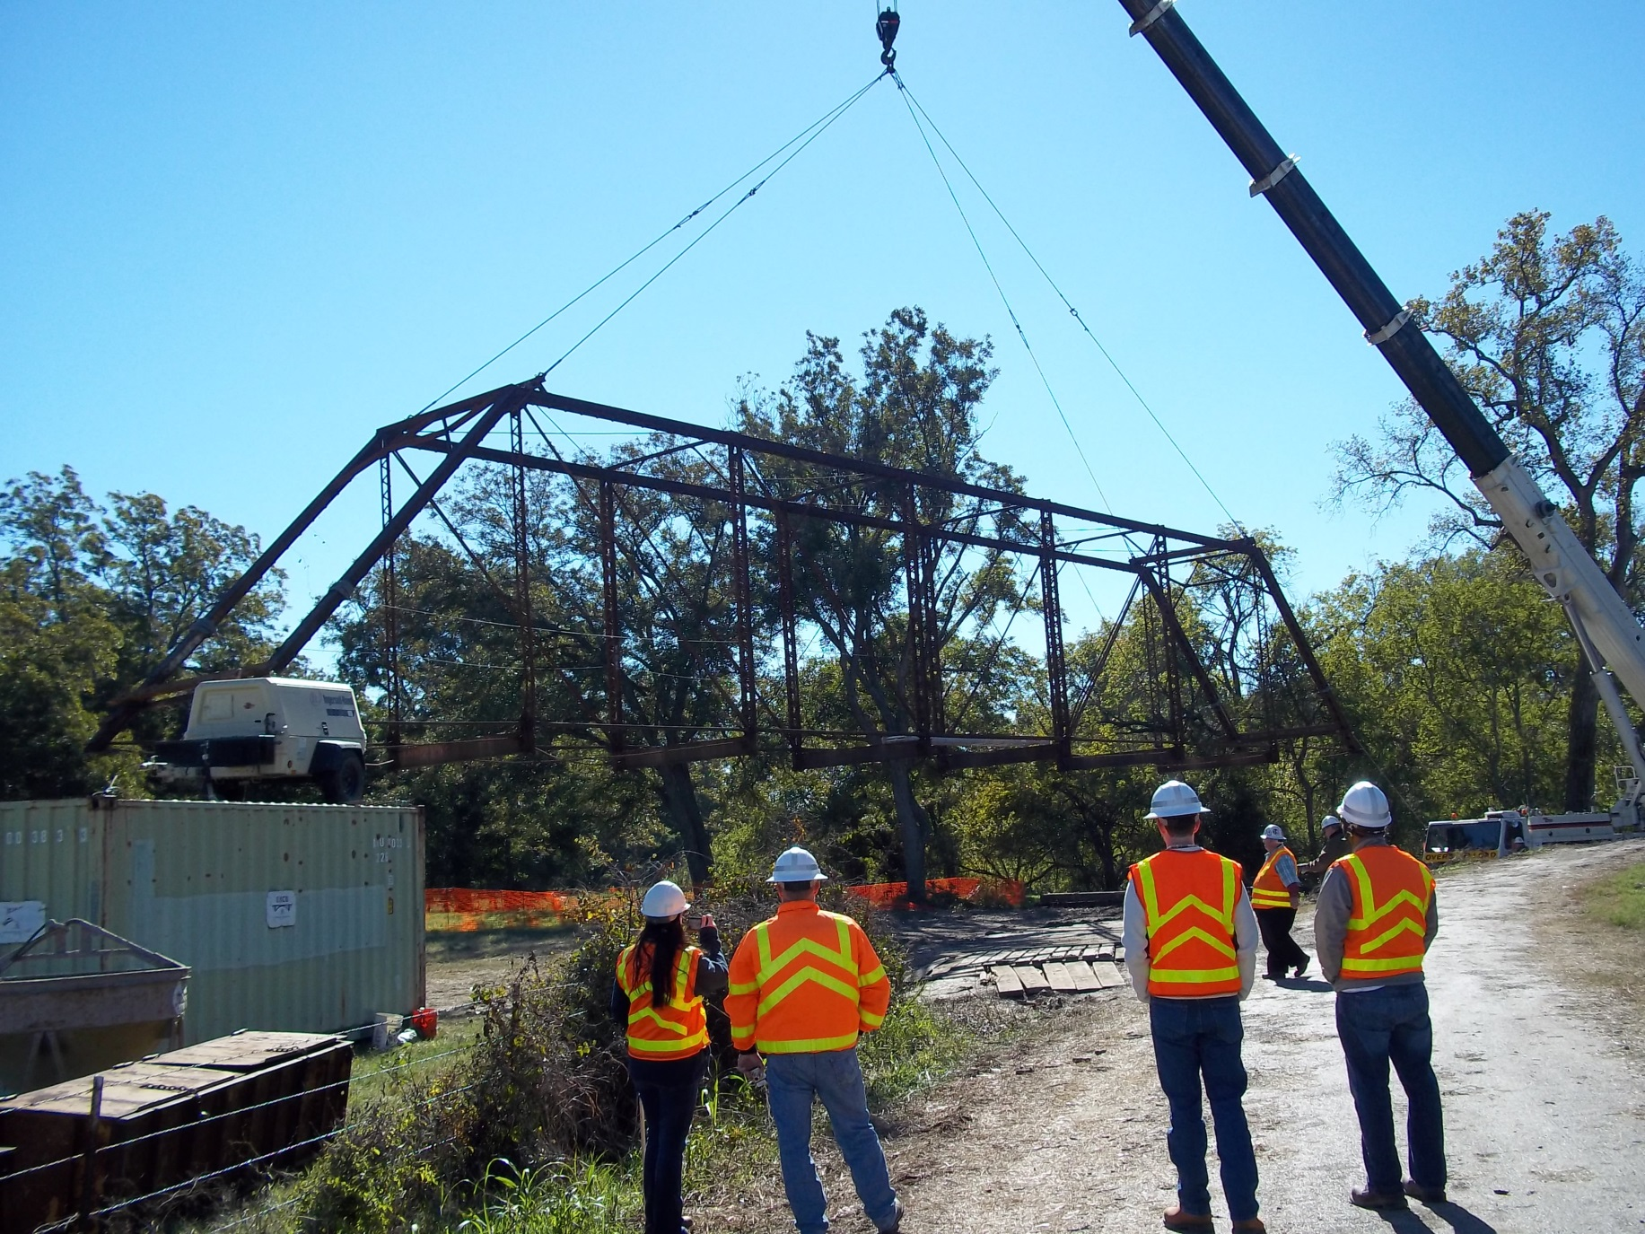
My Bridge is Historic, Now What?
Notes:
Having a historic bridge means something when it comes to spending federal funds. If you are working with TxDOT to rehabilitate or replace a historic bridge on your county road, it’s not as simple as replacing a non-historic bridge. Federal money requires:
Considering alternatives to replacement, such as bypassing, moving, or turning in to a one-way pair
Talking to others interested in historic preservation and historic bridges, such as the County Historical Commission or the Historic Bridge Foundation
Consulting with the Texas Historical Commission about the plans for the project
Looking for new owners that may be willing to take over the historic bridge for a new use
These things take time and money to work through, and have the potential to impact public relations or political relationships.

Slide 43
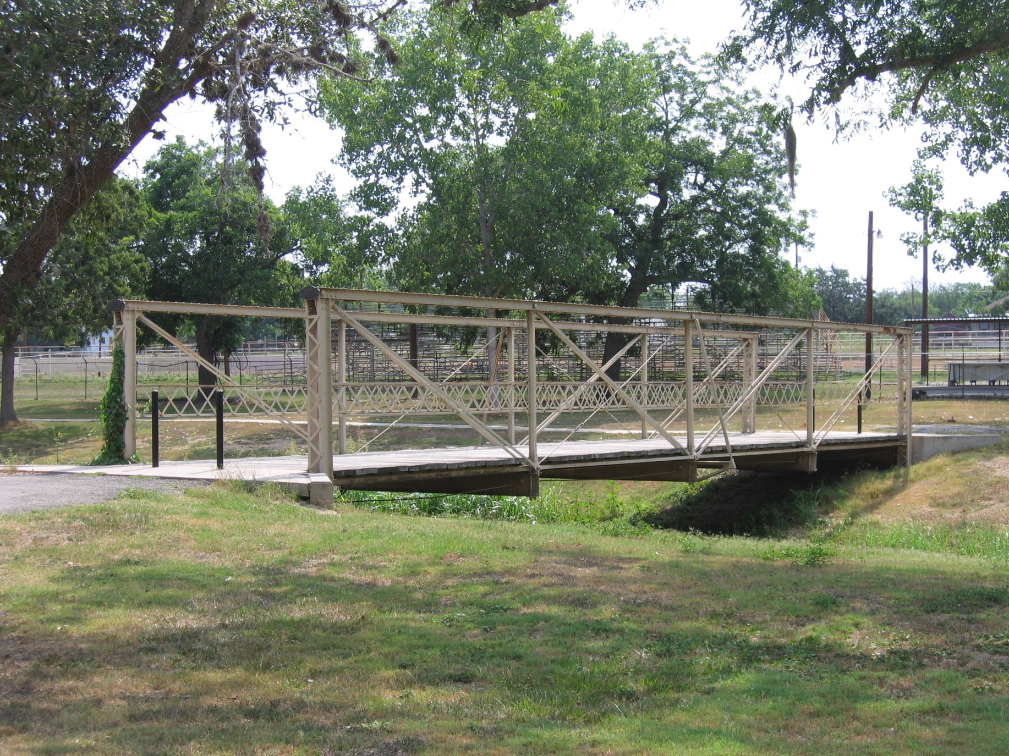
New Uses for Old Bridges
Notes:
Texas is one of the more successful states in the nation to find new uses for old bridges. We have historic bridges serving on hike and bike trails, in parks, as artifacts in museums, and in a golf course.
TxDOT has a well-established procedure for moving historic bridges, and we often provide lifting details and abutment plans for cities and counties looking to reuse historic bridges.

Slide 44
Historic Bridge Resources
Notes:
Did you know there is a Historic Bridge Foundation? While they serve the entire nation, they are based in Austin, Texas, and can serve as a resource for you.
You can also visit the TxDOT or Texas Historical Commission websites, and search keyword “historic bridges” for our historic bridge webpages.

Slide 45
QUESTIONS?
Jeff Tomkins, P.E.
TxDOT Bridge Division
512-416-2225
Jeff.Tomkins@txdot.gov
Rebekah Dobrasko
TxDOT Environmental Division – Historical Studies
(512) 416-2570
Rebekah.Dobrasko@txdot.gov

Slide 46
Copyright Notice
Copyright 2018 • Texas Department of Transportation • All Rights Reserved
Entities or individuals that copy and present state agency information must identify the source of the content, including the date the content was copied. Entities or individuals that copy and present state agency information on their websites must accompany that information with a statement that neither the entity or individual nor the information, as it is presented on its website, is endorsed by the State of Texas or any state agency. To protect the intellectual property of state agencies, copied information must reflect the copyright, trademark, service mark, or other intellectual property rights of the state agency whose protected information is being used by the entity or individual. Entities or individuals may not copy, reproduce, distribute, publish, or transmit, in any way this content for commercial purposes. This presentation is distributed without profit and is being made available solely for educational purposes. The use of any copyrighted material included in this presentation is intended to be a “fair use” of such material as provided for in Title 17 U.S.C. Section 107 of the U.S. Copyright Law.

