Slide 1
Create Drug and Alcohol Testing Policies for County Employees
Larry Boccaccio, Risk Control Consultant
Diana Cecil, Human Resource Consultant
Notes:
Welcome to todays session on How to Create A Drug and Alcohol Testing Policy for County Employees. My name is Diana Cecil and I am the HR Consultant for the NE part of the state. Larry Boccaccio is your other speaker today and he is the Risk Control Consultant for the South and Southwest part of the state. We are happy to have you here today and hope this session will be informative to you and your county. We have provided the regulatory code throughout the presentation and will provide at the end links and tools to assist you when you get back into your counties.

Slide 2
Disclaimer
This training is designed to provide general information about the subject matter covered. Neither TAC nor the trainers are engaged in rendering legal advice. If you need legal advice, TAC recommends that you seek the services of a competent attorney who is familiar with your specific situation.
Notes:
Please read our disclaimer.

Slide 3
Learning Objectives
Be able to describe the differences in regular county employee drug and alcohol testing and CDL DOT Federal Regulation Drug and Alcohol testing requirements.
Gain knowledge of the five different types of CDL DOT Federal Drug and Alcohol Tests.
Be able to communicate back to your county the requirements of what must be included in all drug and alcohol policies.
Be able to develop your county drug and alcohol testing policies by applying practice and utilizing tools provided during the training session.
Notes:
These are the learning objectives for todays session. You should be able to:
Be able to describe the differences in regular county employee drug and alcohol testing and CDL DOT Federal Regulation Drug and Alcohol testing requirements.
Gain knowledge of the five different types of CDL DOT Federal Drug and Alcohol Tests.
Be able to communicate back to your county the requirements of what must be included in a CDL Drug and Alcohol Policy.
Be able to develop your county Drug and Alcohol Testing policies by applying practice and utilizing tools provided during the training session.

Slide 4
Non-CDL Employees – Best Practices
Have a Drug and Alcohol Policy for all employees
Include in your policy:
Pre-employment Testing
Reasonable Suspicion Testing
Post Accident Testing
NOTE: Do Not Include Random Testing
Notes:
We will start the session with a brief discuss about drug testing for all positions other than your mandatory CDL positions.
It is a recommended best practice to have a drug testing policy for all employees. The policy should describe the employees responsibilities and requirements for your tolerance to drug and alcohol in the workplace.
Private Sector employers in Texas are free to conduct any type of drug testing on employees. Government employers are not so free, due mainly to court decisions holding that testing employees without showing some kind of compelling justification violates government employees' rights to be safe from unreasonable searches and seizures, 4th Amendment violation. Drug testing is not for everyone. A County should do it only after careful consideration of many factors, including applicable statutes and regulations and combatting some perceived problem with substance abuse among the workers. Drug testing, for example, must be mandated for some types of employees, as is the case with workers subject to U.S. Department of Transportation mandatory testing guidelines. Some federal grants may require employers to adopt drug-free workplace policies and possibly even to provide for drug-testing of employees. Other employers may be under no legal obligation to do testing, but feel it is needed due to reports that some employees may be unsafe due to being under the influence of drugs or alcohol. Regardless of the reason for testing, it is essential to carefully draft the policy and consider the various legal issues.
As a county you may include in your policy, with signed waivers recommended, pre-employment testing, reasonable suspicion testing and post accident testing.
You may include across the board random drug testing for your employees.
We recommend that you discuss with your county attorney if any of your positions will meet the strict standards set up by numerous court cases. The Texas Attorney General has opined with Opinion No. JM-1274
Re: Authority of a sheriff to require his employees to submit to random drug testing (RQ-1952) and stated that “The Texas constitutional guarantee of privacy would be violated by random urine testing of deputy sheriffs and jailers for the presence of drugs where no compelling governmental objective for the testing has been shown.”
Consult with your County Attorney for any Random Drug Testing plan other than your CDL Drivers.

Slide 5
Non-CDL Policy Recommendations
A good basic policy should include:
A statement on the objectives of the policy
Definitions
Who is covered under the policy
What is considered a violation
What types of testing will be done
What disciplinary measures will be taken
Notes:
A good basic policy should include:
An overall statement on the objectives of the policy.
Sample County intends to help provide a safe and drug-free work environment for our Employees and the Public we serve. With this goal in mind and because of the serious drug abuse problem in today's workplace, we are establishing the following policy for existing and future employees of Sample County.
Next definitions are important to tell us what we mean, example for alcohol, what is a positive. I have reviewed some county policies and the policy will define alcohol violation as .08, well then I can come to work completely under the influence to the legal level.
Then who are we covering under this policy, if you are not covering all employees, then you need to spell out who the policy covers.
Example what is the county going to prohibit.
The County explicitly prohibits:
The use, possession, solicitation for, or sale of narcotics or other illegal drugs, alcohol, or prescription medication without a prescription on county premises or while performing an assignment.
Being impaired or under the influence of legal or illegal drugs or alcohol away from the county premises, if such impairment or influence adversely affects the employee's work performance, the safety of the employee or of others.
Possession, use, solicitation for, or sale of legal or illegal drugs or alcohol away from the County premises, if such activity or involvement adversely affects the employee's work performance, the safety of the employee or of others.
The presence of any detectable amount of prohibited substances in the employee's system while at work, while on the premises of the county, or while on county business. "Prohibited substances" include illegal drugs, alcohol, or prescription drugs not taken in accordance with a prescription given to the employee.
Next if you plan on doing any types of testing, this needs to be spelled out.
The county will conduct drug and/or alcohol testing under any of the following circumstances:
Pre-employment testing of all applicant.
Reasonable Suspicion Testing: The county may ask an employee to submit to a drug and/or alcohol test at any time it feels that the employee may be under the influence of drugs or alcohol, including, but not limited to, the following circumstances: evidence of drugs or alcohol on or about the employee's person or in the employee's vicinity, unusual conduct on the employee's part that suggests impairment or influence of drugs or alcohol, negative performance patterns, or excessive and unexplained absenteeism or tardiness.
Post Accident Testing: Any employee involved in an on-the-job accident or injury under circumstances that suggest possible use or influence of drugs or alcohol in the accident or injury event may be asked to submit to a drug and/or alcohol test. "Involved in an on-the-job accident or injury" means not only the one who was or could have been injured, but also any employee who potentially contributed to the accident or injury event in any way.
Next what disciplinary action might occur. If an employee is tested for drugs or alcohol and the results indicate a violation of this policy, or if an employee refuses a request to submit to testing under this policy, the employee may be subject to appropriate disciplinary action, up to and possibly including discharge from employment.

Slide 6
Federal Motor Carrier Safety Administration Regulations
FMCSA
49 CFR Part 40
- Specifies employer responsibilities
- Specifies how to conduct these tests
- Specifies what procedures to use
- Specifies confidentiality and release of information
Notes:
FMCSA is very specific in it’s requirements.
Under 49 CFR Part 40 the regulation specifies employer responsibilities, how tests are to be conducted and evaluated what procedures to use and confidentiality and release of information.
The Federal Motor Carrier Safety Regulations are contained in Subchapter B, Chapter III, Subtitle B of the “Code of Federal Regulations (CFR)”, Title 49-Transportation.

Slide 7
Federal Motor Carrier Safety Administration Regulations
FMCSA
49 CFR Part 382
- Specifies prohibitions and consequences of drug and alcohol use
- Specifies which test are required and when
- Specifies alcohol misuse and controlled substances use information, training, and referral.
Notes:
FMCSA is very specific in it’s requirements.
Under 49 CFR Part 382 the regulation specifies the prohibitions and consequences of drug and alcohol use. It also specifies which tests are required and when are they required. It specifies alcohol misuse and controlled substances use information, training and referral.
The Federal Motor Carrier Safety Regulations are contained in Subchapter B, Chapter III, Subtitle B of the “Code of Federal Regulations (CFR)”, Title 49-Transportation.

Slide 8
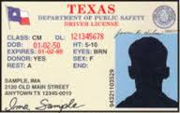
Who Do We Test?
Commercial Drivers License(CDL) holder operating Commercial Motor Vehicle with Gross Vehicle Weight or Gross Combination Weight rating of 26,001 pounds
Full Time Employees
Part Time Employees
Temporary Employees
Volunteers
Notes:
We have to test anyone that we are allowing to drive for the county that holds a CDL and is driving a commercial motor vehicle with Gross Vehicle Weight or Gross Combination Weight rating of 26,001 pounds. That will include full time employees, part time employees, temporary employees and volunteers. They will need to be tested if they frequently or occasionally drive for the county.
CMV
Gross combination weight rating or gross combination weight of 26,001 pounds or more, whichever is greater, inclusive of a towed unit (s) with a gross vehicle weight rating or gross vehicle rate of more than 10,000 pounds.
Has a gross vehicle weight rating or gross vehicle weight of 26,001 or more pounds.
Is designed to transport 16 or more passengers, including the driver.
Is of any size and is used in the transportation of materials found to be hazardous for the purposes of the Hazardous Materials Transportation Act and which the motor vehicle to be placarded under the Hazardous Materials Regulations (49 CFR part 172, subpart F)

Slide 9
CDL Policy Development
FMCSA requires each county with CDL drivers to develop a written policy (382.601)
Notes:
Under FMCSA 382.601 each county with CDL drivers operating CMVs must develop a written policy. Alcohol misuse and controlled substance abuse, information, training and referral.

Slide 10
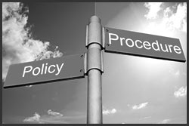
CDL Policy Requirements
Required Policy Statement
Short statement describing policy objectives (382.601)
Definitions (382.107)
Categories of drivers subject to testing (382.103)
All CDL drivers operating CMV must be tested
Participation is a requirement of employment
Your policy must state that all CDL drivers operating a CMV must participate in the program
Notes:
We will cover what they FMCSA requires to be included in your policy in the next few slides. We have given you the regulation number if you need to look it up a later date,
You are required to have a policy statement that describes your policy objectives. You also need to define words or concepts used in your policy. You have state all the categories of drivers that will be included in your policy. Reminder that any CDL driver operating a covered CMV must be included in the testing. You also need a statement that indicates participation in this program is a requirement of employment.

Slide 11
CDL Policy Requirements
Required Hours of Compliance
Alcohol Rule (382.205, 07, 09)
- On Duty
- 4 hours prior to duty
- 8 hours post accident or until employee undergoes post accident testing
Controlled Substance Rule (382.213)
- May not report or remain on duty
* Exception – Use is at instruction of physician who advised will not adversely affect employee
Notes:
When does an employee have to comply per the regulation. The Alcohol Rules states they may not use alcohol while on duty, 4 hours prior to duty or 8 hours post accident or until the employee undergoes post accident testing. The Controlled Substance Rule states that they may not report or remain on duty if using a controlled substance. There is an exception to this rule that indicates a physician can advise that it will not adversely affect the employee. Best practice would be to require a doctors note for this exception.

Slide 12
CDL Policy Requirements
Employee Prohibited Behavior Rules
Improper use of alcohol
Improper use of drugs
Possession of alcohol or drugs
Possession of drug paraphernalia
Prescriptions/Over the Counter Drugs
Adulterants
Notes:
Your policy must include statements on employee prohibited behavior rules. These are prohibited by your employees, improper use of alcohol, improper use of drugs, possession of alcohol or drugs while at work, possession of drug paraphernalia, use of prescriptions or over the counter drugs, or use of adulterants while being tested.
An adulterant is a substance used to alter the urine test.

Slide 13
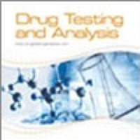
CDL Policy Requirements
Circumstances for Testing (382, Subpart C)
Pre-employment
Random
Reasonable Suspicion
Post Accident
Return to Duty
Follow Up
NOTE: Your policy must be detailed to inform drivers what circumstances will trigger a test
Notes:
The regulation is clear about what tests must be conducted. They include pre-employment, random, reasonable suspicion, post accident, return to duty and follow up.
You must take notice that your policy is required to be detailed and inform drivers under what circumstances a test will be trigged.

Slide 14
CDL Policy Requirements
Behavior that Constitutes Refusal (382.107, 382.211)
Inability to provide sufficient quantity of breath, saliva or urine (without a medical explanation)
Tampering or adulterating or MRO reports such
Interfering with testing procedure
Not immediately report to collection site
Failing to remain at collection site until released
Leaving an accident without a valid reason before test can be conducted
Notes:
The regulation details what behavior will constitute a refusal. You must include this in your written policy. They are:
Inability to provide sufficient quantity of breath, saliva or urine (without a medical explanation)
Tampering or adulterating or MRO reports such
Interfering with testing procedure
Not immediately report to collection site
Failing to remain at collection site until released
Leaving an accident without a valid reason before test can be conducted

Slide 15
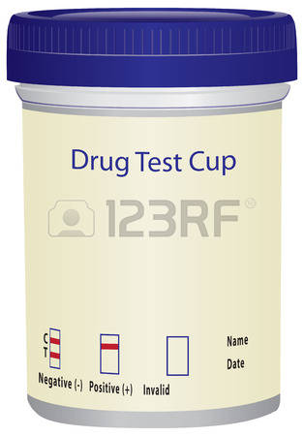
CDL Policy Requirements
Testing Procedures – How to Do It (49 CFR Part 40)
Controlled substance test will be performed with a split sample and analysis reviewed by MRO
Alcohol tests – breath or saliva
Privacy of employee is protected
Integrity of test is maintained
Test results attributed to correct driver
Post accident conducted with specific instructions to driver
Records and results only released to those authorized (382.405)
Notes:
Your policy must contain details of how you conduct your drug and alcohol testing. You must follow the regulation.
Testing procedures are:
Controlled substance test will be performed with a split sample and analysis reviewed by MRO
Alcohol tests – breath or saliva
Privacy of employee is protected
Integrity of test is maintained
Test results attributed to correct driver
Post accident conducted with specific instructions to driver
Records and results only released to those authorized (382.405)

Slide 16
CDL Policy Requirements
Consequences of Positive Tests
Alcohol
- .02 to .04 the employee shall not perform or continue to perform safety sensitive functions for 24 hours following test (382.505)
- .04 or greater is mandatory removal from safety sensitive function (382.5)
- Less than .02 is considered a negative test
- Refusal to submit to test
NOTE: This is minimum requirements. The regulation does not stop you from terminating.
Notes:
You must have the consequences of positive test spelled out in your policy. These are the minimum consequences required by the FMCSA. Nothing in the regulation requires you to keep an employee. The regulation lets the employer decide when to terminate.
Alcohol
- .02 to .04 the employee shall not perform or continue to perform safety sensitive functions for 24 hours following test (382.505)
- .04 or greater is mandatory removal from safety sensitive function (382.5)
- Less than .02 is considered a negative test
- Refusal to submit to test

Slide 17
CDL Policy Requirements
Consequences of Positive Tests
Controlled Substance Abuse
- Verified positive controlled substance test result
- Refusal to submit to test
NOTE: This is minimum requirements. The regulation does not stop you from terminating.
These result in mandatory evaluation by a substance abuse professional – Even if your policy allows/requires for termination (382.503)
Driver must have a Return to Work follow up Negative drug test before being reinstated
Notes:
You must have the consequences of positive test spelled out in your policy. These are the minimum consequences required by the FMCSA. Nothing in the regulation requires you to keep an employee. The regulation lets the employer decide when to terminate.
Controlled Substance Abuse
- Verified positive controlled substance test result
- Refusal to submit to test
NOTE: This is minimum requirements. The regulation does not stop you from terminating.
These result in mandatory evaluation by a substance abuse professional – Even if your policy allows/requires for termination (382.503)
Driver must have a Return to Work follow up Negative drug test before being reinstated

Slide 18
CDL Policy Requirements
Identify a Contact Person
Must designate a person to answer questions about your alcohol misuse and controlled substance use program
You must include the telephone number and location address.
Notes:
The policy must include a designation of a person who can be contacted to answer questions about your drug and alcohol program. It must also include their telephone number and a location address.

Slide 19
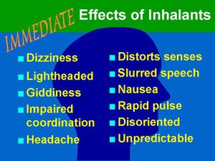
CDL Policy Requirements
Effects of Alcohol and Controlled Substances
Alcohol and substance use can negatively affect:
Vision
Coordination
Aggressiveness
Reflexes
Emotions
Judgement
Driving Ability
Notes:
You must include in your policy the effects of alcohol controlled substance such as vision, coordination, aggressiveness, reflexes, emotions, judgement, driving ability

Slide 20
CDL Policy Communication
Must make sure drivers are aware of policy and the affect it has on them
Must provide written materials to explain regulations, policy and corresponding procedures to all CDL drivers (382.601)
Must require a CDL driver to sign a certificate of receipt of materials and keep on file (382.601(d))
Notes:
You must provide your CDL Drivers in written materials information that explains the regulation, a copy of the policy and any corresponding procedures. You also must require all CDL drivers to sign a certification of receipt of these materials and keep that on file.

Slide 21
CDL Supervisor Requirements
All supervisors designated to supervise CDL drivers must take Reasonable Suspicion Training (382.603)
1 Hour Controlled Substance Training
1 Hour Alcohol Misuse Training
NOTE: Recurrent training is not required, but all new supervisors must complete.
Notes:
All supervisors designated to supervise CDL drivers must complete 1 hour of controlled substance training and 1 hour of alcohol misuse training. Recurrent training is not required but all new supervisors must receive this training in a timely manner.

Slide 22
Overview
You may have a drug testing policy for non-CDL drivers to include pre-employment, reasonable suspicion or post accident
Counties who have CDL drivers operating CMV with GVW or GCW of 26,001 pounds must have a CDL written policy and testing program to include pre-employment, random, reasonable suspicion, post accident, return to work and follow up testing.
Policy must be communicated in writing and a certificate of receipt must be on file for all CDL drivers.
Supervisors must have reasonable suspicion training of 1 hour each for controlled substance and alcohol misuse,
Notes:
You must provide your CDL Drivers in written materials information that explains the regulation, a copy of the policy and any corresponding procedures. You also must require all CDL drivers to sign a certification of receipt of these materials and keep that on file.

Slide 23
Resource Links
Regulations
https://www.fmcsa.dot.gov/regulations/drug-alcohol-testing/overview-drug-and-alcohol-rules-employers
Policy Development
https://www.fmcsa.dot.gov/regulations/drug-alcohol-testing/implementation-guidelines-alcohol-and-drug-regulations-chapter-3
Be a Driver in the Know – FMCSA Employee Brochure
https://www.fmcsa.dot.gov/regulations/drug-alcohol-testing/drug-and-alcohol-testing-brochure-drivers

Slide 24
Questions

Slide 25
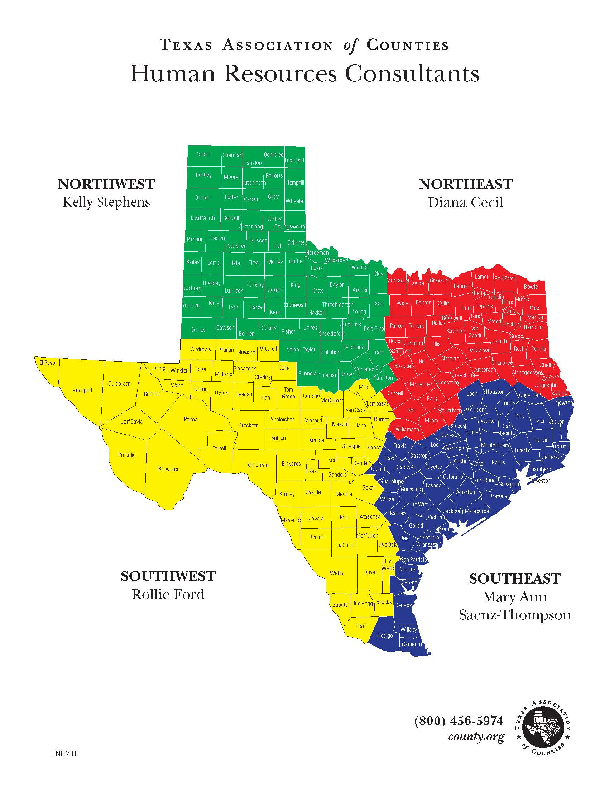
Northwest
Kelly Stephens
Northeast
Diana Cecil
512-461-1667
512-924-6360
dianac@county.org
Southeast
Mary Ann Saenz-Thompson
512-921-9056
Southwest
Rollie Ford
rollief@county.org
kellys@county.org
maryanns@county.org
Member Service
Michele Arseneau
michelea@county.org
1-800-456-5974
512-680-1994
Notes:
If you have any questions regarding this content, please contact your TAC HR consultant

